Slide 1
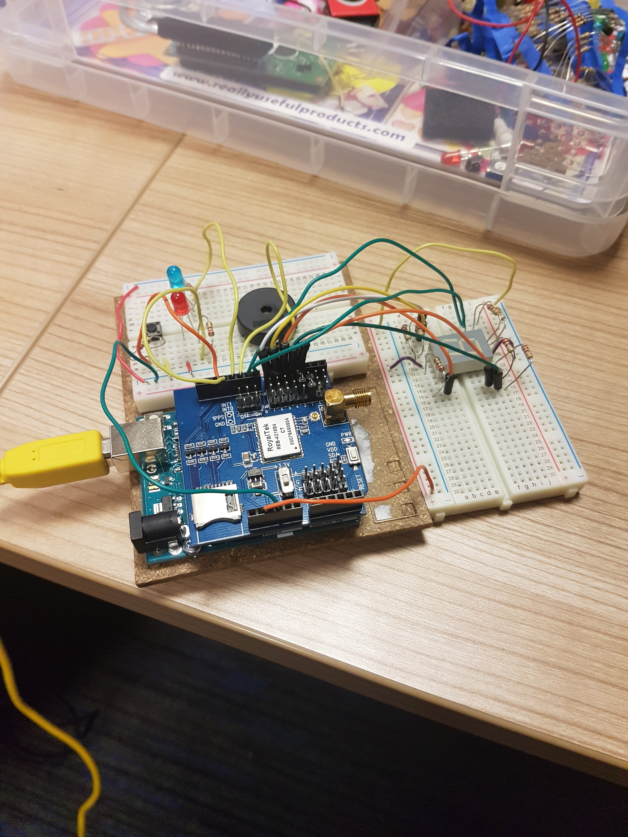
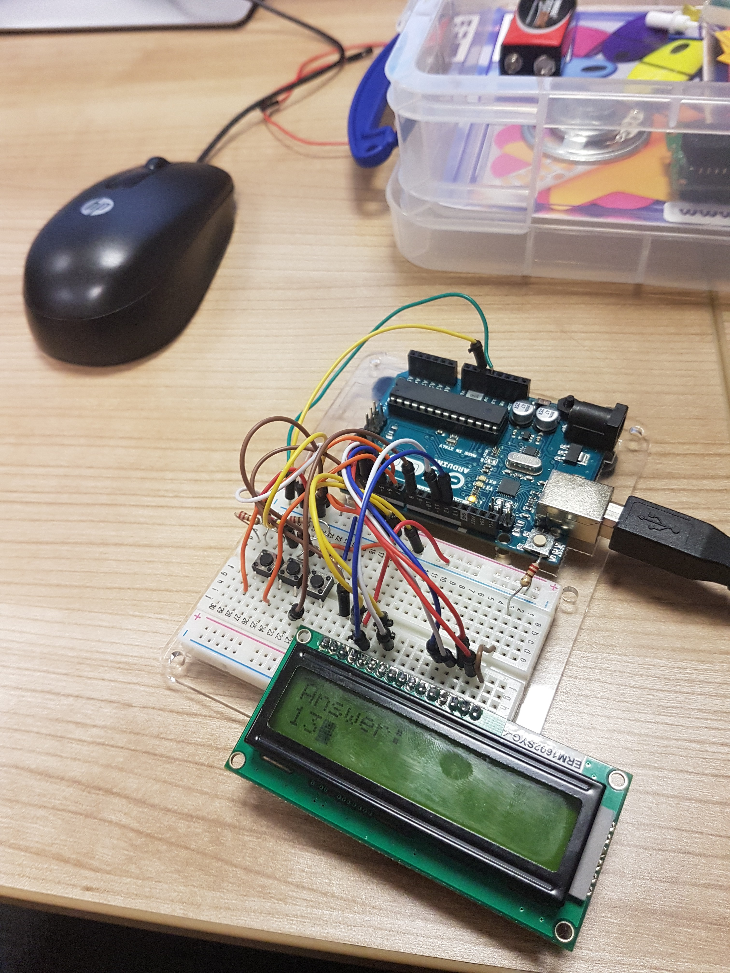
Hot and Cold GEOCACHING DEVICES
Creating hot and cold geocachING deviceS using Arduino uno boards
Ross WILLIAMS – P4107911
Sean Johnson – Q5040916
Darien Goodwin-Madden – P4049754

Slide 2
THE PROJECT GOALS
Create two Arduino Uno devices for use with Geocaching recreational activities.
A Hot and Cold Device.
A Treasure Chest Device.
Create a desktop application that communicates with both Arduino devices to provide goal positions and treasure chest password digits.
Produce a product that can be used anywhere, anytime.
Produce a product that provides a user friendly and fun experience.
Fill a hole in the market for Arduino Geocaching devices (dominated by Smartphones).

Slide 3
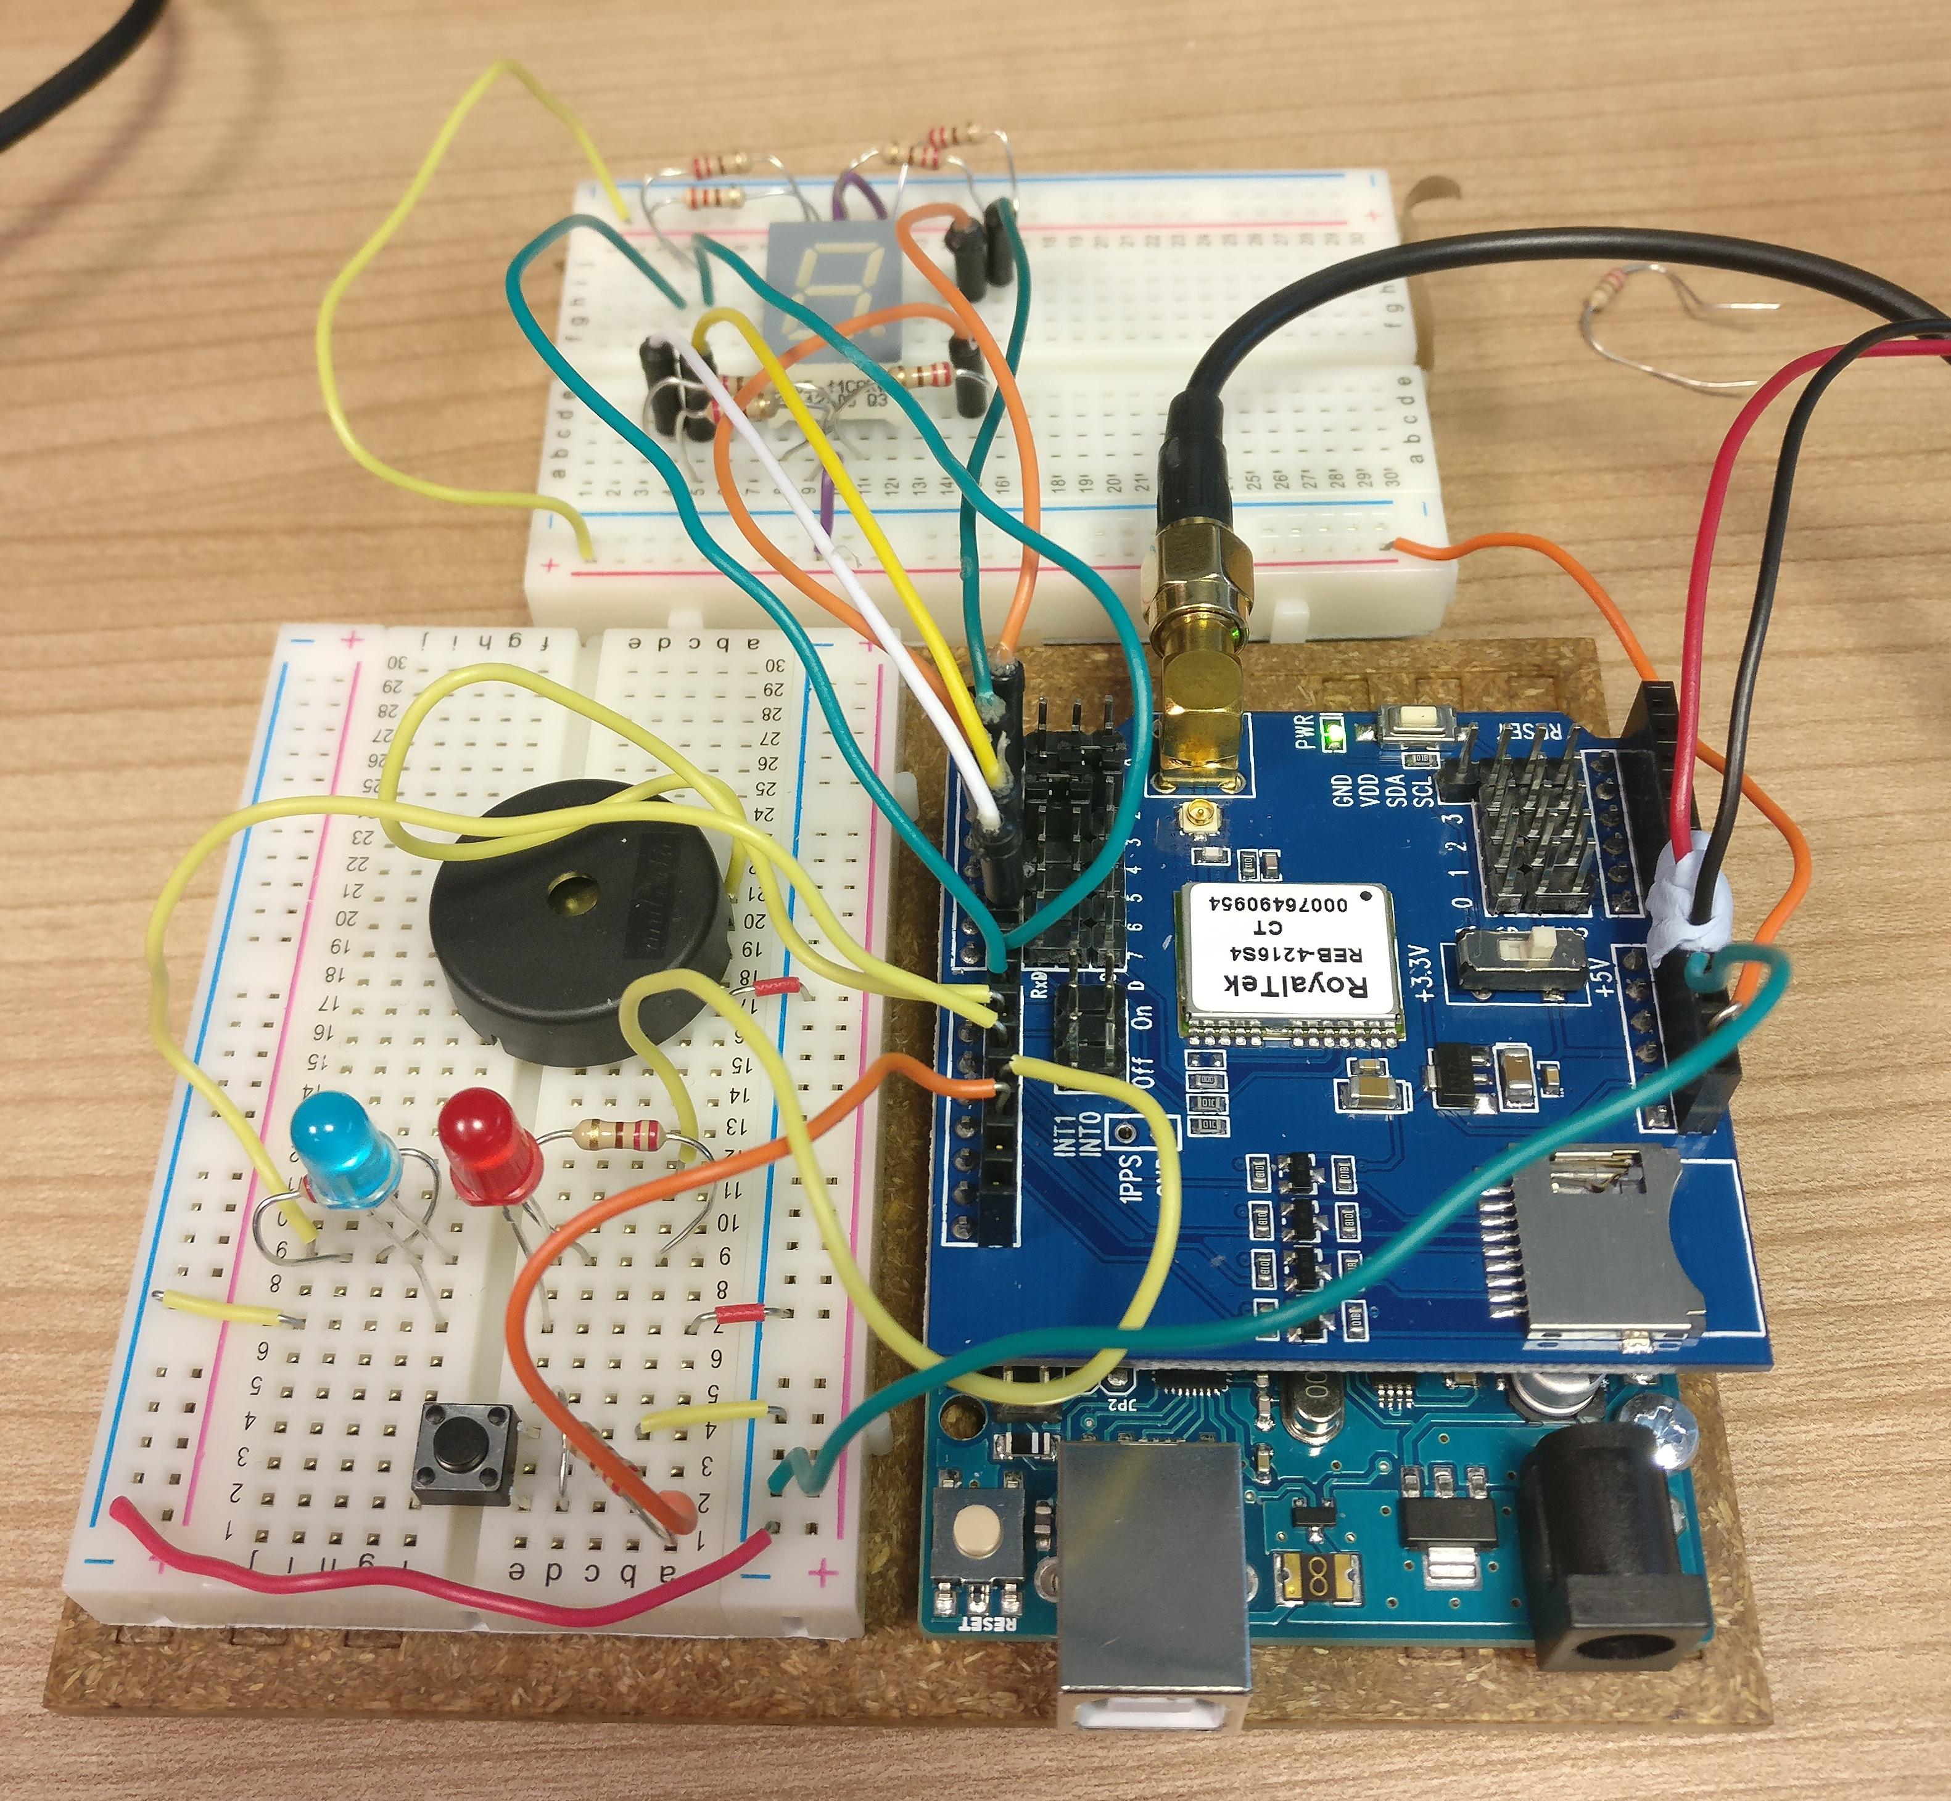
HOT AND COLD DEVICE REQUIREMENTS
Track the current users position using longitude and latitude from a GPS shield.
Store the coordinates of up to 3 positions in the world.
Compare the users current coordinates to goal coordinates (one of the stored coordinates).
Identify if the users current position is closer (hotter) or further away (colder) than the previous position.
Alert the user if they are hotter or colder.
When the user gets 10 meters (configurable) from the goal position:
Display a digit between 0-9. This digit is used to unlock the treasure chest device.
Output a sound using a speaker to alert the user of the displayed digit.
Portable.

Slide 4
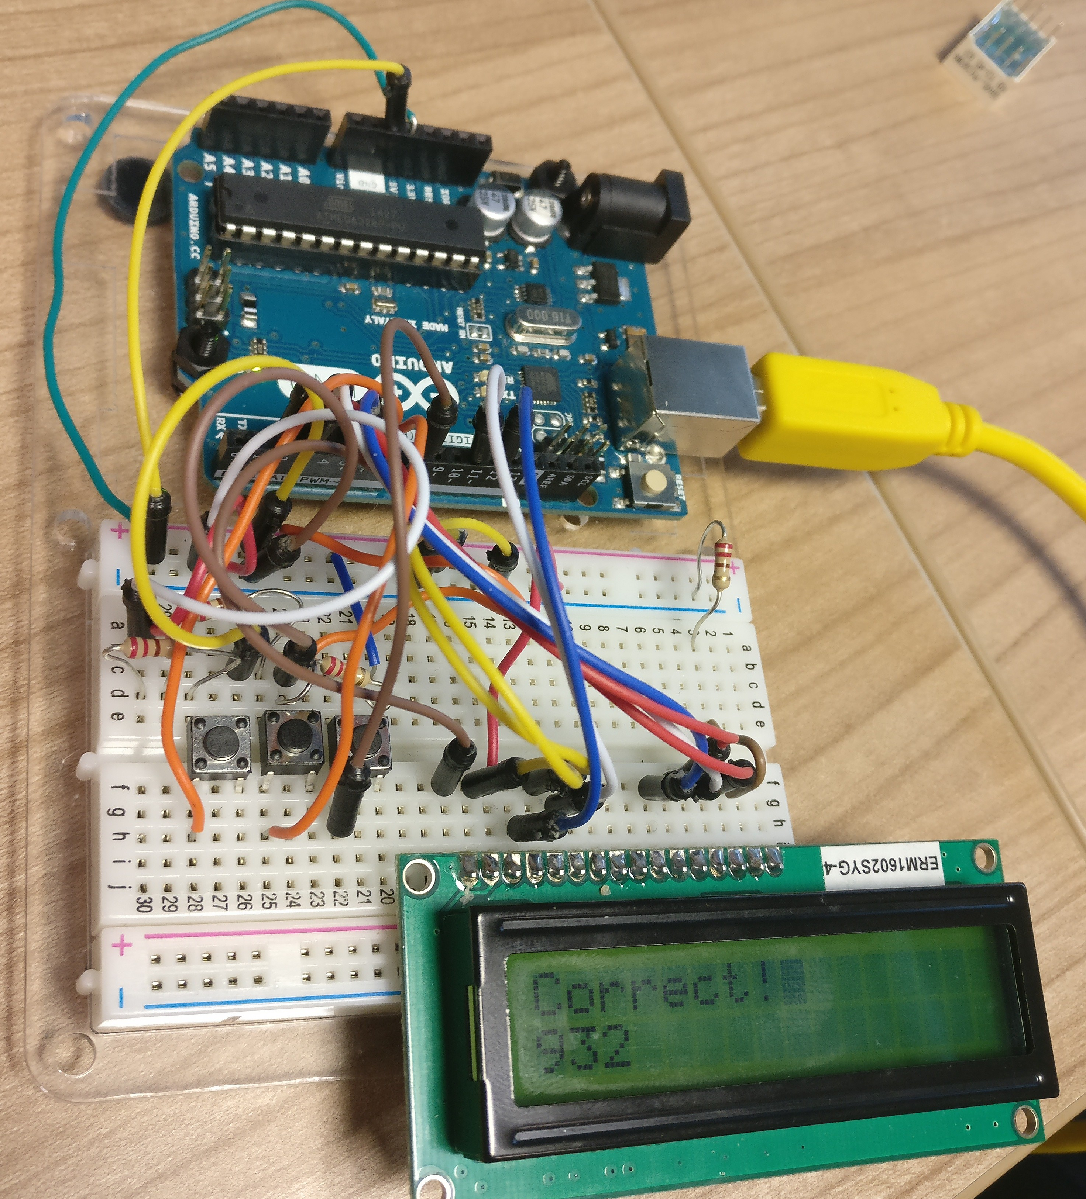
Treasure Chest Device Requirements
Store a password (between 1 and 3 digits) used to unlock the device.
Allow users to manually enter the password output from the Hot and Cold device.
Alert the user if the entered answer is correct or incorrect using a Liquid Crystal Display.
Portable.

Slide 5
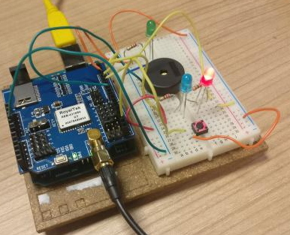
STAGes OF DEVELOPMENT (Hot and COLD Device)
Prototype 1
GPS Shield integrated. Coordinates of user are tracked.
Green LED and speaker implemented to alert user of GPS attempting to get signal.
Speaker outputs a sound when the user is within 10 meters of the hardcoded goal position.
Hot (RED) and Cold (BLUE) LEDs implemented with a button.
Upon pressing the button, the current users coordinates are compared to a hard coded goal position and the appropriate LED is lit.
Basic distance calculation using Pythagoras is implemented.

Slide 6
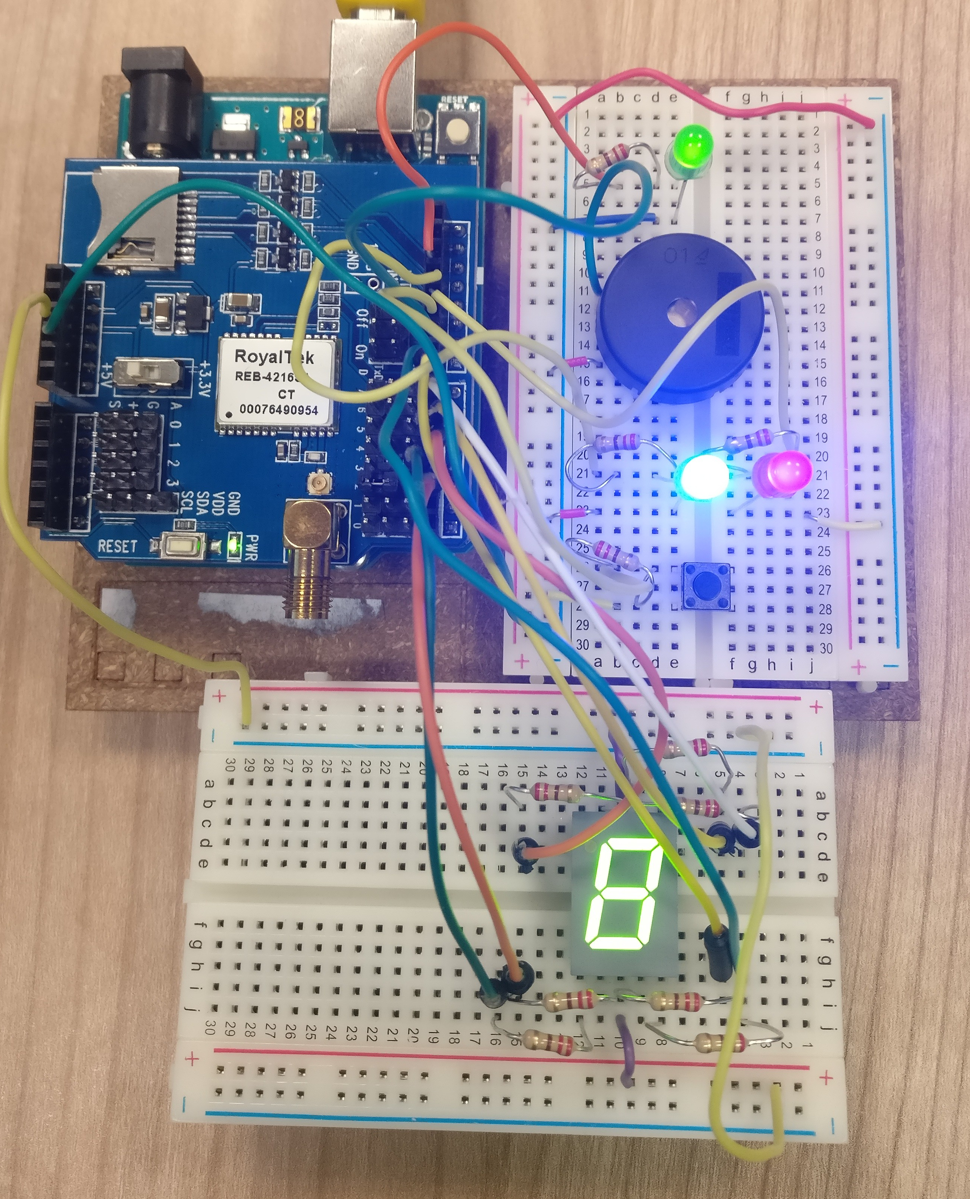
STAGES OF DEVELOPMENT (HOT AND COLD DEVICE)
Prototype 2
Now communicates with the developed coordinate input desktop application:
Goal coordinates and treasure chest password digits can now be stored in the Arduinos EEPROM (up to 3 goal positions and password digits).
Hot and Cold switch now compares the users current position with a non hardcoded goal position.
The current goal position is updated to the next goal position when the user gets 10 meters from the original goal position.
Distance calculation is improved to be more accurate.
7-Segement Display implemented.
7-Segement Display outputs a digit between 0 and 9 when the user gets to the goal position as provided via the coordinate input desktop application.

Slide 7
STAGES OF DEVELOPMENT (HOT AND COLD DEVICE)
Prototype 3 – Current Version
Now portable by implementing a 9 volt battery pack.
Still experiencing issues with keeping power due to issues with the pack.
Green LED removed due to lack of usable pins.
Pin 2 was causing issues to occur when both the 7-Segement Display and the GPS were in use.
Client mode implemented.
Default mode when first powering the device.
No other device functionality is usable when in this mode.
Used for communication between the device and the coordinate input desktop application.
Can be disabled by pressing the Hot and Cold switch once.

Slide 8
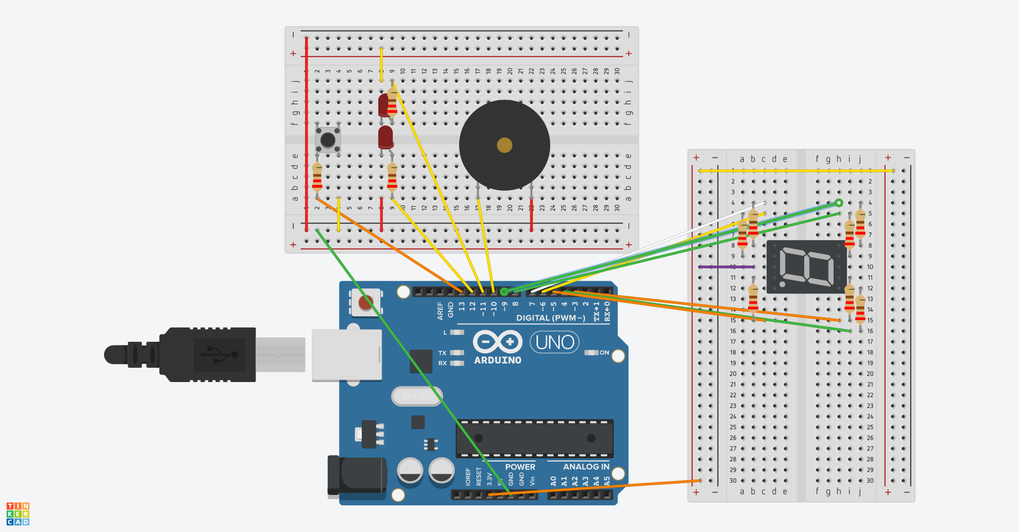
HOT AND COLD DEVICE CIRCUIT
Created using Tinkercad (Tinkercad, n.d.)

Slide 9
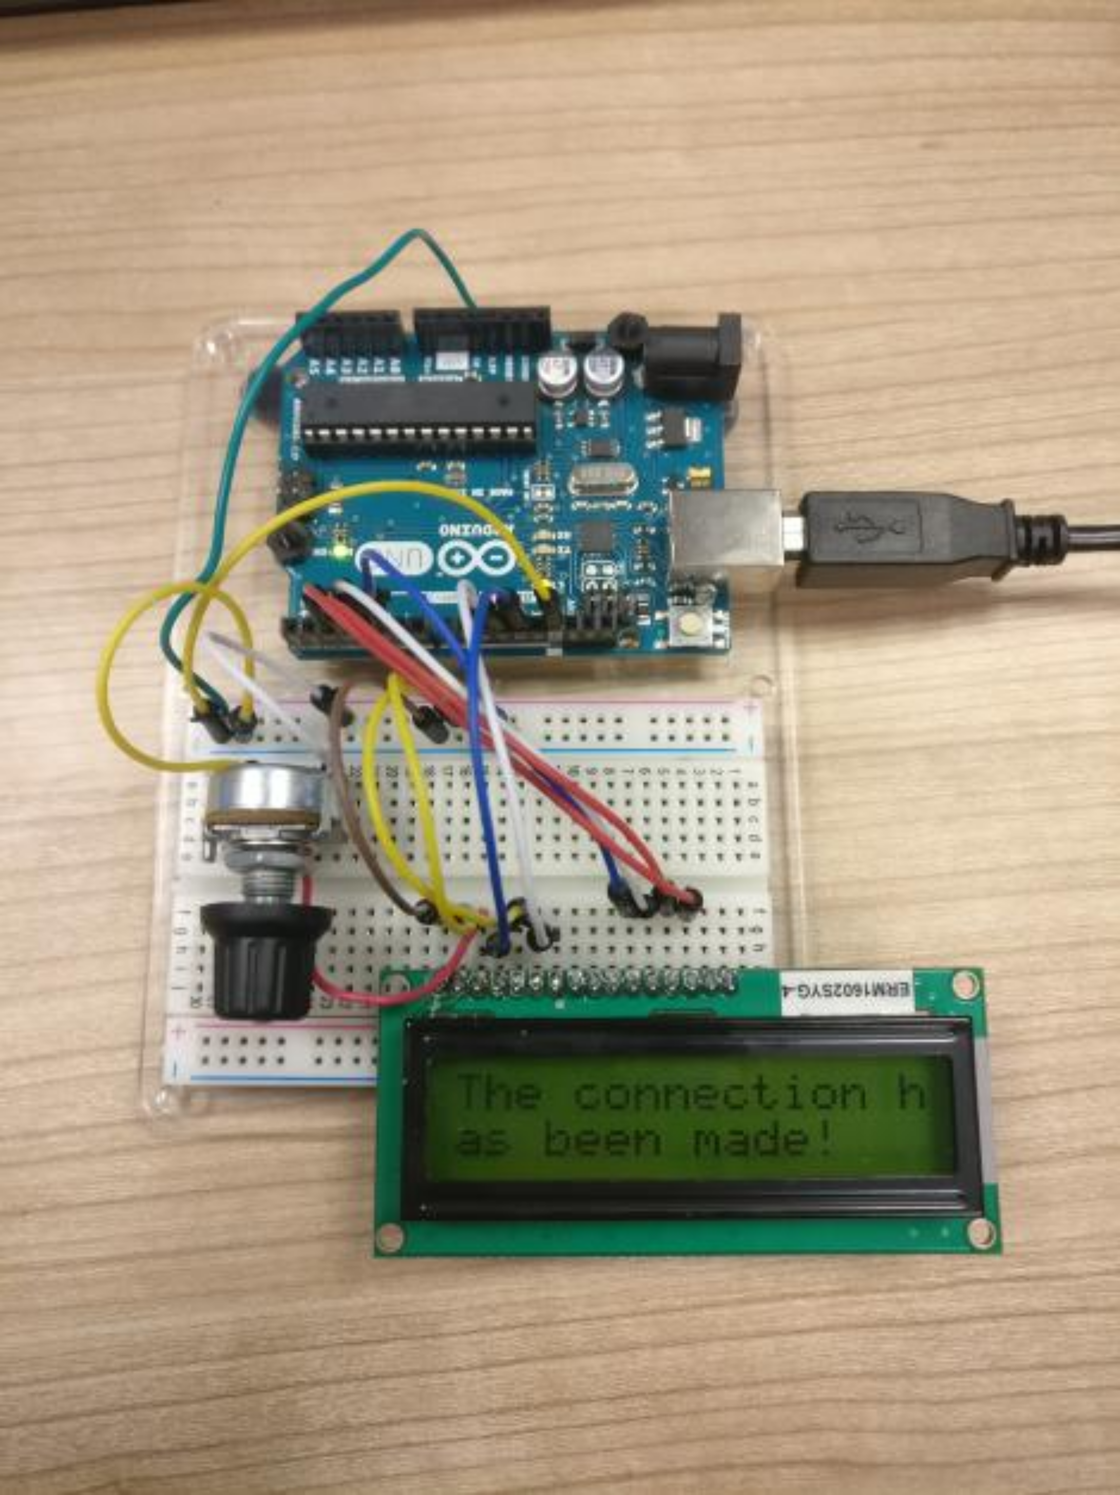
STAGes OF DEVELOPMENT (TREASURE CHEST Device)
Prototype 1
LCD implemented using the example provided by Arduino.cc (Arduino.cc, 2015).
Potentiometer implemented.
Communication with coordinate input desktop application established:
Goal positions and treasure chest password digits stored within the boards EEPROM.
“The connection has been made!” is displayed on the LCD to verify a successful connection with the application
Goal coordinates displayed once entered to verify storage in EEPROM.

Slide 10
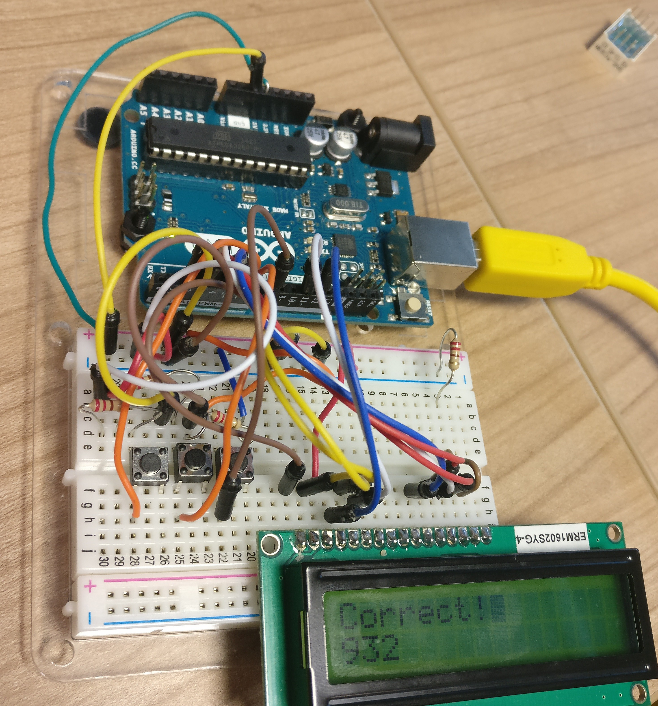
STAGes OF DEVELOPMENT (TREASURE CHEST Device)
Prototype 2 – Current Version
3 switches implemented, potentiometer removed:
Left Switch: Increments the currently selected digit by 1. Loops back to 0 after hitting 9.
Middle Switch: Sets the cursor to the next digit to the right. Loops back to the first digit after reaching the final digit.
Right Switch: Confirm button. Checks if the entered password matches the expected password.
LCD displays “Correct” or “Wrong” depending on the results of checking the entered password.
Client mode implemented.
Default mode when first powering the device.
No other device functionality is usable when in this mode.
Used for communication between the device and the coordinate input desktop application.
Can be disabled by holding down the left switch and middle switch at the same time.

Slide 11
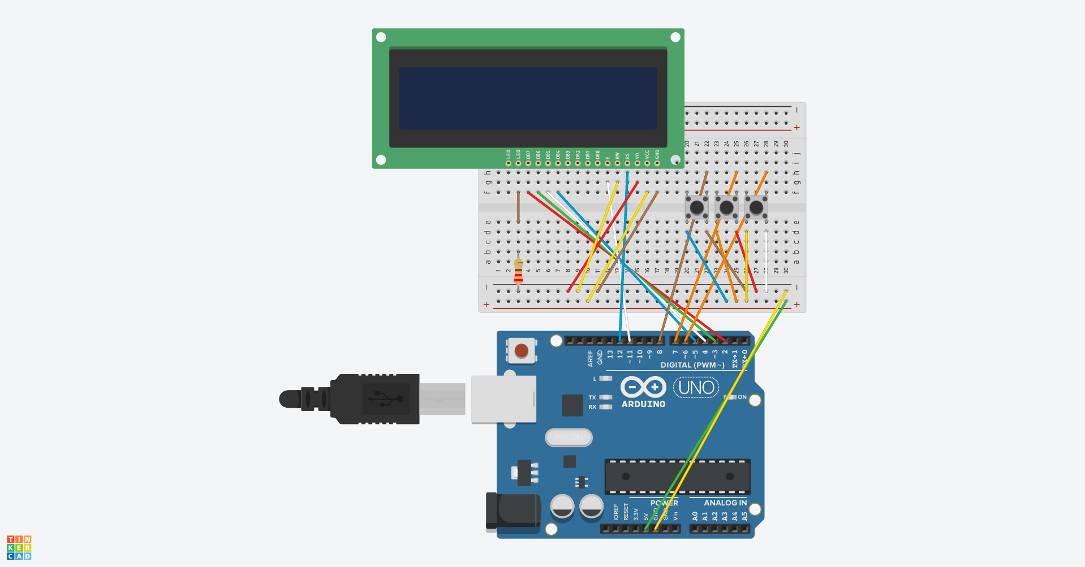
TREASURE CHEST DEVICE CIRCUIT
Created using Tinkercad (Tinkercad, n.d.)

Slide 12
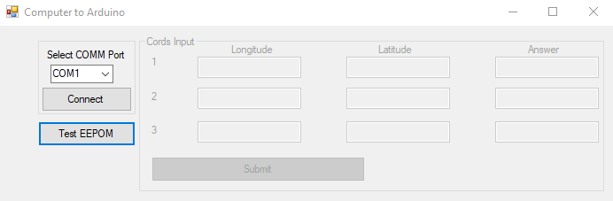
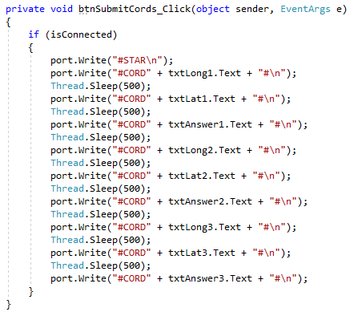
COORDINATE INPUT DESKTOP APPLICATION
Video: https://www.youtube.com/watch?v=LaXGZ5VIVe

Slide 13
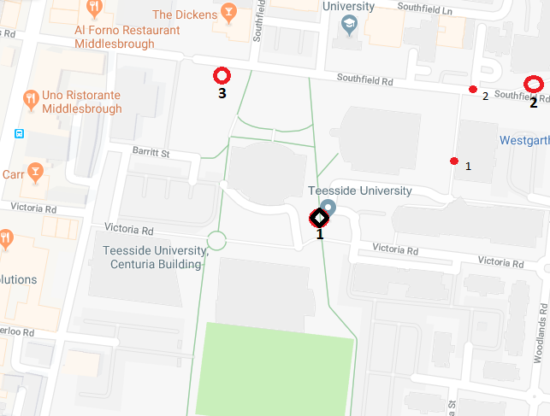
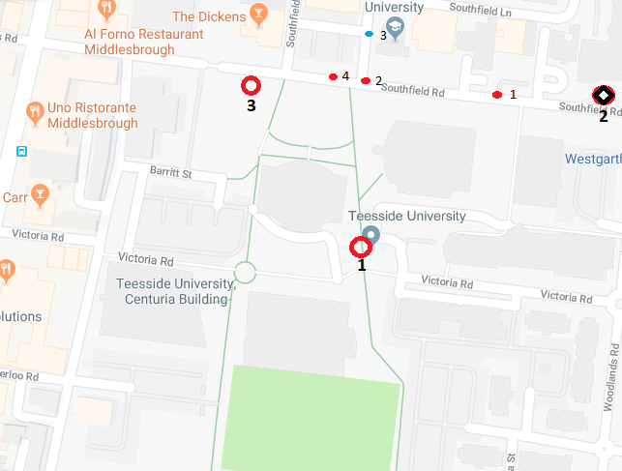
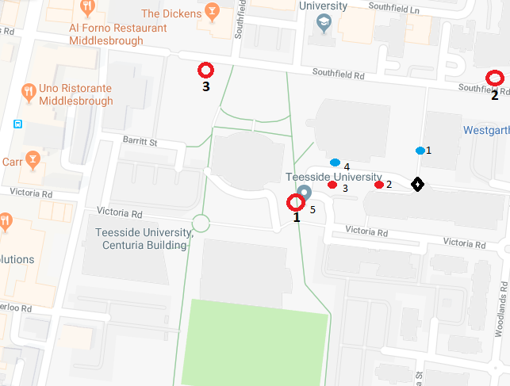
PROJECT DEMONSTRATION
Goal Position 1 Route
Goal Position 2 Route
Goal Position 3 Route
Video: https://www.youtube.com/watch?v=a7WrcUpYKdw

Slide 14
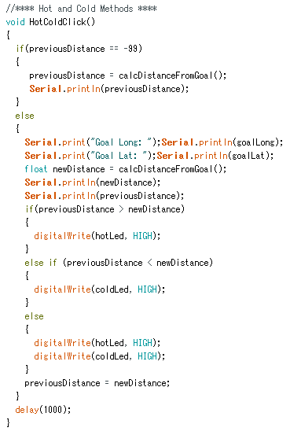
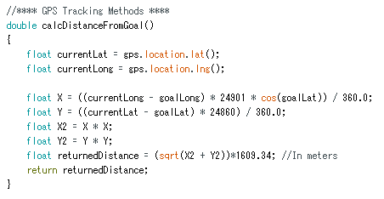
HOT AND COLD DISTANCE CALCULATION CODE
HotColdClick:
Checks if the previous distance has been calculated (not -99).
Calculates the new distance using the calcDistanceFromGoal method.
Compares the newDistance to previousDistance.
If previousDistance is larger, the HOT LED is turned on.
If previousDistance is smaller, the COLD LED is turned on.
If equal, both LEDs are turned on.
calcDistanceFromGoal:
Grabs the current longitude and latitude.
Calculates the X and Y distance taking the Earths shape into consideration. (Arduino Stack Exchange, 2016).
Squares the X and Y distance for use in Pythagoras.
Converts distance to meters.

Slide 15
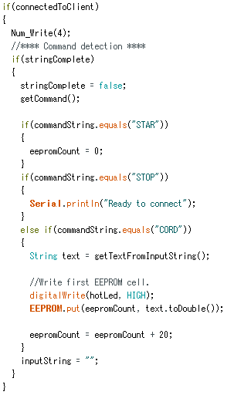
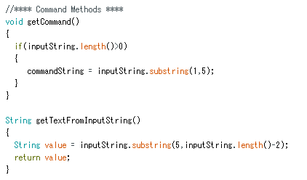
HOT AND COLD CLIENT MODE CODE
getCommand:
Sets the commandString variable to the first 4 characters of the passed string (the command).
getTextFromInputString:
Returns the VALUE of the passed string (after the command and # sign).
Identifies which command is requested (STAR, STOP or CORD):
CORD command takes the provided value and stores it into the boards EEPROM.
eepromCount is incremented by 20 (address of the data in the EEPROM).
Resolved Bugs:
Values stored in the EEPROM previously varied from the original value (3.144 => 3.142). Fixed by incrementing the eepromCount by 20 instead of 10.
CORD command was not executed for every passed value. Fixed by creating a client mode avoiding Delay calls.

Slide 16
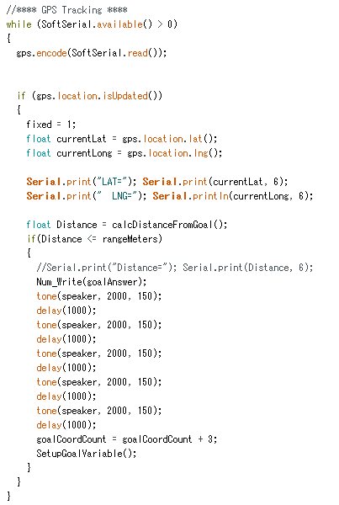
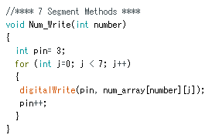
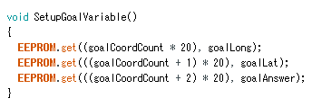
HOT AND COLD GPS TRACKING CODE
While the GPS is available:
Check if the location of the GPS has changed.
If true, calculate the current distance from the goal state.
If the calculate distance is less than or equal to the specified range (10 meters):
Write the next password digit to the 7-Segment display (Num_Write).
Alert the user by outputting a sound from the speaker.
Increment the goalCoordCount variable by 3 (used for grabbing data from the EEPROM).
Set the next goal state and password digit using SetupGoalVariable.

Slide 17
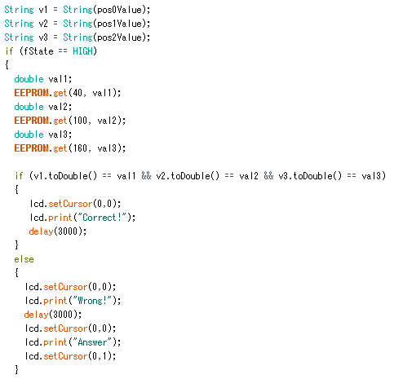
TREASURE CHEST CONFIRM PASSWORD CODE
Check if fState (the state of the confirm button) is HIGH. If true:
Each password digit is retrieved from the EEPROM (40, 100 and 160 are the addresses of the password digits).
Check if each of the entered password values are equal to the stored password values.
If true, display the word “Correct” to the LCD.
If false, display the word “Wrong” and after 3 seconds, reset the display to the password entering state.

Slide 18
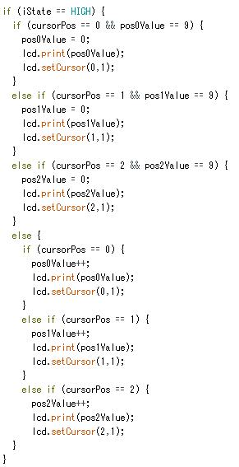
OTHER BUGS AND ISSUES
Hot and Cold switch state bug.
The state (on or off) of the hot and cold switch would randomly change. This caused the Hot and Cold functionality of the board to be executed when not requested.
Resolved by changing the PIN the switch was connected to (previously was pin 2).
7-Segment and GPS usage bug.
The 7-Segment display and the GPS could not be used at the same time.
Originally believed this was a power issue.
Resolved by removing the use of PIN 2 altogether. Resulted in the GREEN LED being removed.
Treasure chest value incrementing bug.
When incrementing a value of 9 by 1, the value would previously increment to 1 instead of 0.
Resolved by rearranging the implemented IF statements (two IF statements were being executed when one was expected).

Slide 19
FUTURE MARKETING/MANUFACTURING
Problems to be resolved:
Portability: Currently there are issues with maintaining power to the boards using the current battery packs. This is not ideal for outdoor usage.
Structural Integrity: The Hot and Cold device is currently very flimsy. This would need to be addressed for future manufacturing due to the location in which these devices will be used.
Elemental Resistance: Water may be a huge problem for the devices due to exposure of electronic components to the elements. Methods should be considered to prevent water from getting onto the boards and causing issues if it does.
The treasure chest device should be fitted to a storage container. Currently the device does not UNLOCK anything.

Slide 20
COMPONENT PRICE LIST
HOT AND COLD DEVICE | PRICE (£) | TREASURE CHEST DEVICE | PRICE (£)
Arduino Uno Board | £20.00 | Arduino Uno Board | £20.00
Arduino Starter Kit | £8.39 | Arduino Starter Kit | £8.39
Breadboard | £4 | Battery Pack | £2.39
Seven-Segment | £1.99 | LCD Display | £1.18
Battery Pack | £2.39
RoyalTek GPS Shield | £20 - £35
Total: £56.77 - £71.77 per device
Total: £31.96 per device
https://store.arduino.cc/arduino-uno-rev3
https://www.amazon.co.uk/TRIXES-Electronics-Solderless-Prototyping-Breadboard/dp/B01AY20WVA/ref=br_lf_m_ag6zjxe5b8566ho_ttl?_encoding=UTF8&s=electronics
https://www.amazon.co.uk/Smraza-Breadboard-Resistors-Mega2560-Raspberry/dp/B01I0ZEK48/ref=sr_1_2?s=electronics&ie=UTF8&qid=1526035378&sr=1-2&keywords=arduino+led+kit
https://www.amazon.co.uk/Seven-Segment-Display-Cathode-Arduino/dp/B07BY4R6NG/ref=sr_1_17?ie=UTF8&qid=1526035593&sr=8-17&keywords=arduino+7+segment
https://www.amazon.co.uk/2xUM-18650-Battery-Connector-Arduino-Shield/dp/B077K7J96P/ref=sr_1_8?s=industrial&ie=UTF8&qid=1526035672&sr=1-8&keywords=arduino+battery+pack
https://www.amazon.co.uk/FACILLA%C2%AE-Character-Display-Blacklight-Electronics-modele-10/dp/B009GEPZRE/ref=sr_1_9?s=electronics&ie=UTF8&qid=1526035479&sr=1-9&keywords=arduino+lcd+display
https://www.itead.cc/itead-gps-shield.html

Slide 21
REFERENCES
Tinkercad. (n.d.). Tinkercad | Create 3D digital designs with online CAD. [online] Available at: https://www.tinkercad.com/ [Accessed 10 May 2018].
Arduino.cc. (2015). Arduino - LiquidCrystalDisplay. [online] Available at: https://www.arduino.cc/en/Tutorial/LiquidCrystalDisplay [Accessed 10 May 2018].
Arduino Stack Exchange. (2016). Measuring The Distance Using GPS programmed with Arduino. [online] Available at: https://arduino.stackexchange.com/questions/23115/measuring-the-distance-using-gps-programmed-with-arduino [Accessed 10 May 2018].
Youngblood, T. (2015). Interface a Seven Segment Display to an Arduino. [online] Allaboutcircuits.com. Available at: https://www.allaboutcircuits.com/projects/interface-a-seven-segment-display-to-an-arduino/ [Accessed 10 May 2018].
Itead.cc. (n.d.). Arduino GPS shield - ITEAD Wiki. [online] Available at: https://www.itead.cc/wiki/Arduino_GPS_shield [Accessed 10 May 2018].
Arduino Stack Exchange. (2014). Button state changing randomly. [online] Available at: https://arduino.stackexchange.com/questions/186/button-state-changing-randomly [Accessed 10 May 2018].

Slide 22
Any Questions?

